Slide 1
Intelligent transportation systems in the Czech Republic
Martin Trpišovský
24. 11. 2015

Slide 2
Short introduction
Martin Trpišovský
PhD student at the University of Pardubice,
Jan Perner Transport Faculty
  Public transport services
Finished master degree in June 2012
  Master thesis focused on social-economical appraisal of building new tram track in the city of Pilsen
2013/2014 in JAMK – School of Technology
martin.trpisovsky@gmail.com

Slide 3

Overview
The electronic toll system
Telematic control used at the Prague Ring
Traffic Management and Information System for Prague trams

Slide 4
The electronic toll system
Electronic Fee Collection (EFC)
4/43

Slide 5


Toll system in the Czech Republic
Started on 1.1.2007
  Vehicles above 12 t
  Vehicles above 3,5 t from 1.1.2010
Kapsch Telamatic Services
  Infrastructure – 22,000 mn CZK / 846 mn €
  Maintanance till 2016 – 2,800 mn CZK / 108 mn €
Income in 2013: 8,555 mn CZK / 316 mn €
  Total in 2007 – 2013: 49,188 mn CZK / 1,822 mn €
Notes:
MPC, MSC, D
Harmonisation, regulation, fiscal reasons

Slide 6
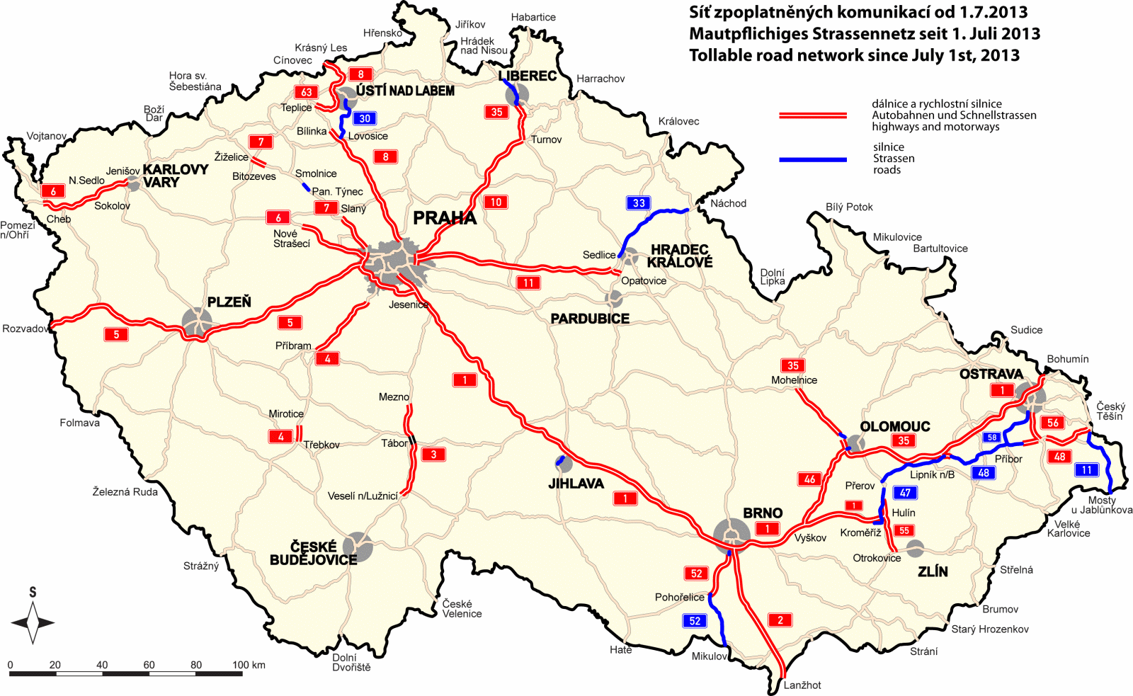
Tollable road network
Notes:
1300 km

Slide 7
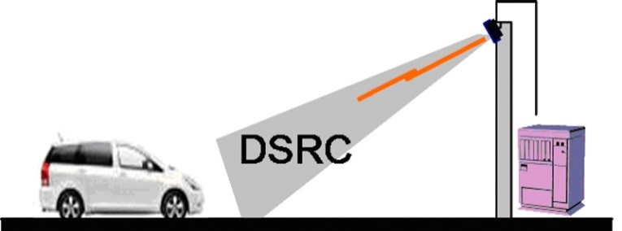
The electronic toll system
Opened EFC system
  Microwave technology (DSRC)
  No negative environmental impact
OBU – OnBoard Unit named „Premid“
  All vehicles subject to pay the toll
  600,000 OBUs
Tolling stations – gantrys which divide
the road network into sections
  200 gantrys
Notes:
Open-road tolling / free flow vs barriered
http://wbb.forum.impressrd.jp/files/images/mob-sec/mob-sec04_zu01_l.jpg

Slide 8
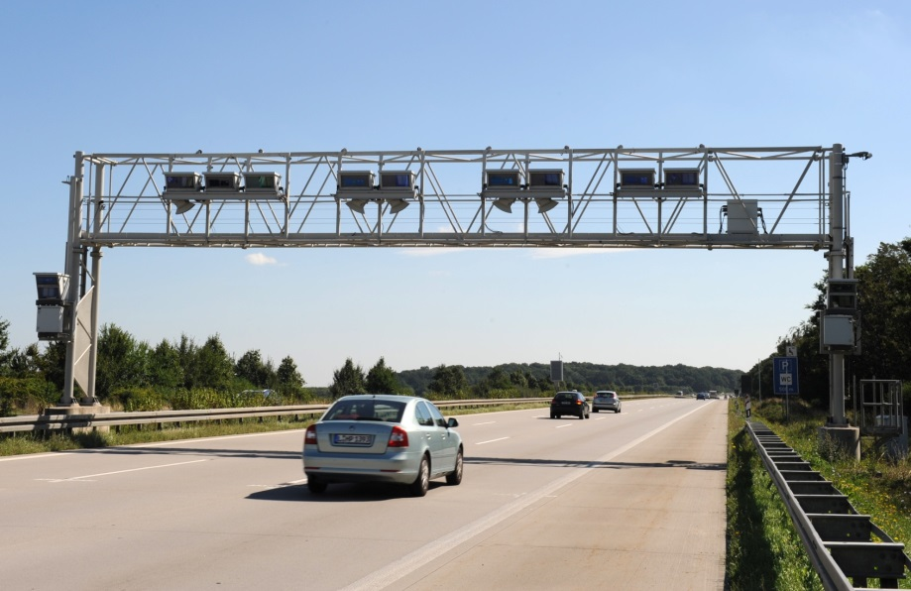
The electronic toll system
When passing the gantry
  No need to slow down or choose specific traffic line
  Accoustic signal from OBU for the driver
Wide discussion about the satelite system
for the rest of road network

Slide 9
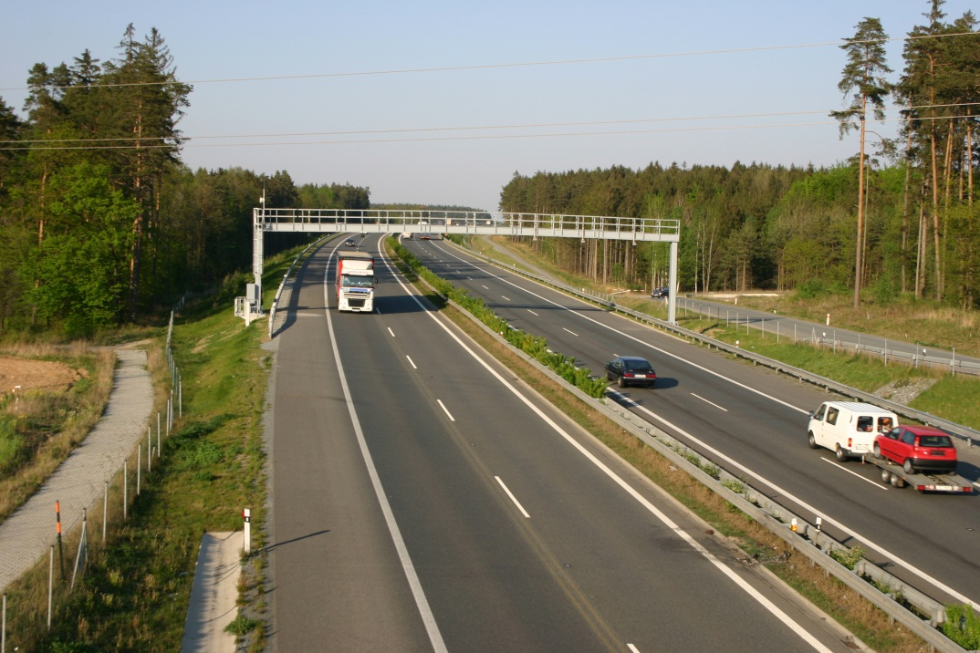
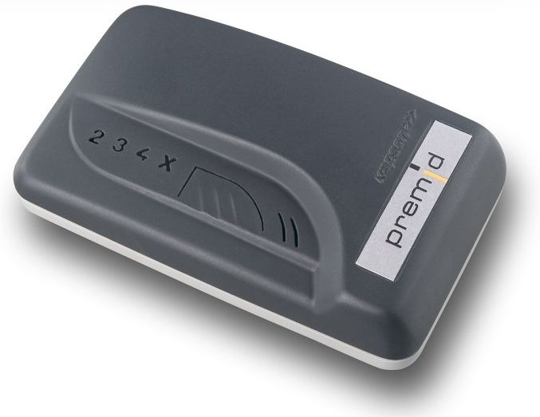
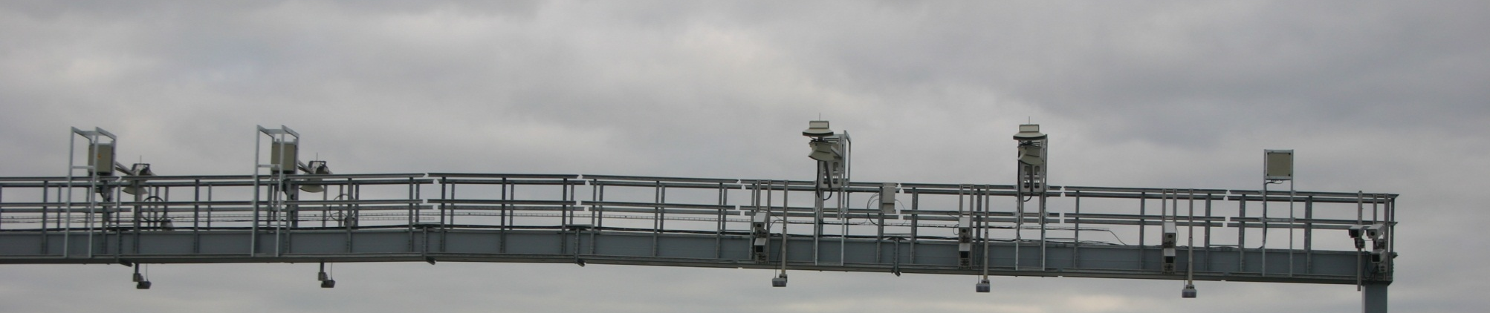
The electronic toll system

Slide 10
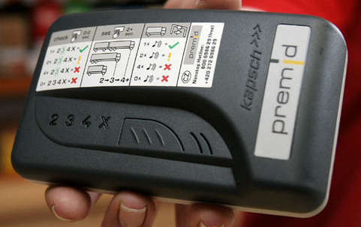
Premid OnBoard Unit
Battery – service life for 3 years
Strips with velcro to install the premid
to windshield
Driver sets the amount of axles (for the toll tariff)
Premid plus with an external antenna for vehicles
with metallised windshields
Beeps everytime when goes through the gantry
Notes:
European emission standards

Slide 11
The electronic toll system
Control stations with cameras at check points
  Checking the use of premids and right tariffs
Toll is collected when it‘s sure the vehicle
had to use certain section
Domestic and foreign road users are charged
the same amount
Account connected to OBU or OBUs
  Prepaid system – credit (signal under 600 CZK / 23 €)
  Postpaid system – postpaid contract
  Cash, payment cards, fleet cards

Slide 12
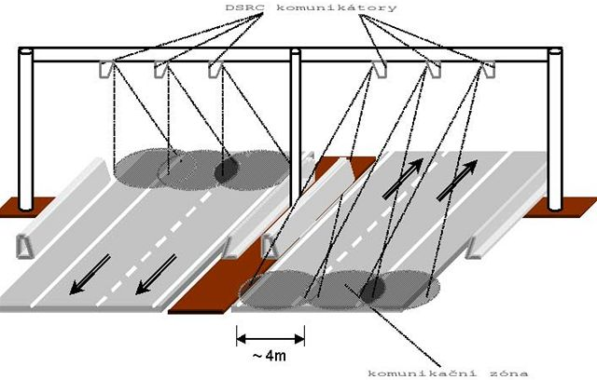
Physical architecture
1. layer: OBUs and toll gantrys (RSE)
2. layer: communication (infrared)
3. layer: service and controlling center
Notes:
RSE – Road Side Equipment

Slide 13
Sources
The electronic toll system in the Czech Republic – official webpage
  http://www.mytocz.eu/en
Czech motorway network information
  http://www.motorway.cz/
Jaroslav Novák: Road Pricing and its Impact
on Road Traffic in the Czech Republic – master degree thesis
  https://www.vutbr.cz/www_base/zav_prace_soubor_verejne.php?file_id=59931

Slide 14
Telematic control used at the Prague Ring
14/43

Slide 15
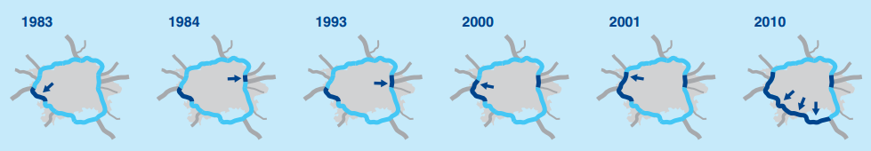
Prague Ring
Express way R1 – beltway around the city
of Prague (40.4 / total 82.7 km)
Traffic flow over 60,000 vehicles per day
  Prognosed more than 120,000 vehicles in 2040
More than 70 bridges and 2 tunnels
  Radotínský bridge – 2,291 m (longest bridge in CZE)
  Tunnel of Zlíchov – 1,620 / 1,661 m

Slide 16
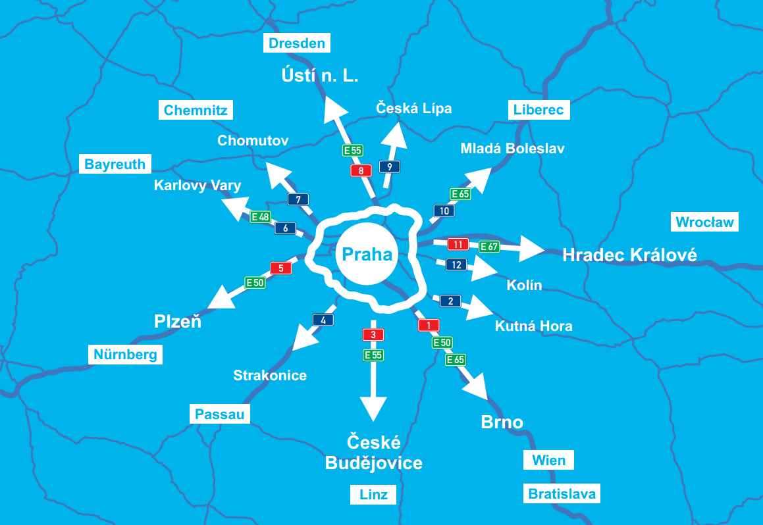
Notes:
expropriation

Slide 17
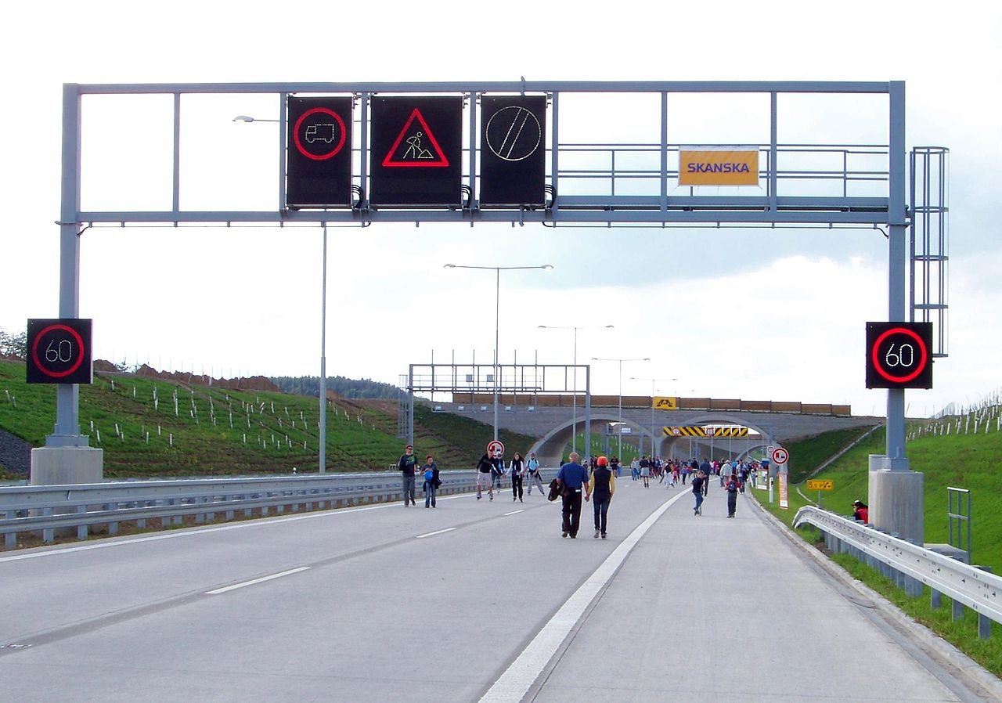
Telematic control used
Most complex system of traffic control in the Czech Republic
System includes changeable traffic signs, light signals, information content, meteorological stations, traffic flow detection sensors
Automative immediate reaction - traffic flow regulation
  Speed and lines limiting
  No entry for freight vehicles (into left one or all lines)
  Glaze ice information
  Traffic accidents, road works information

Slide 18
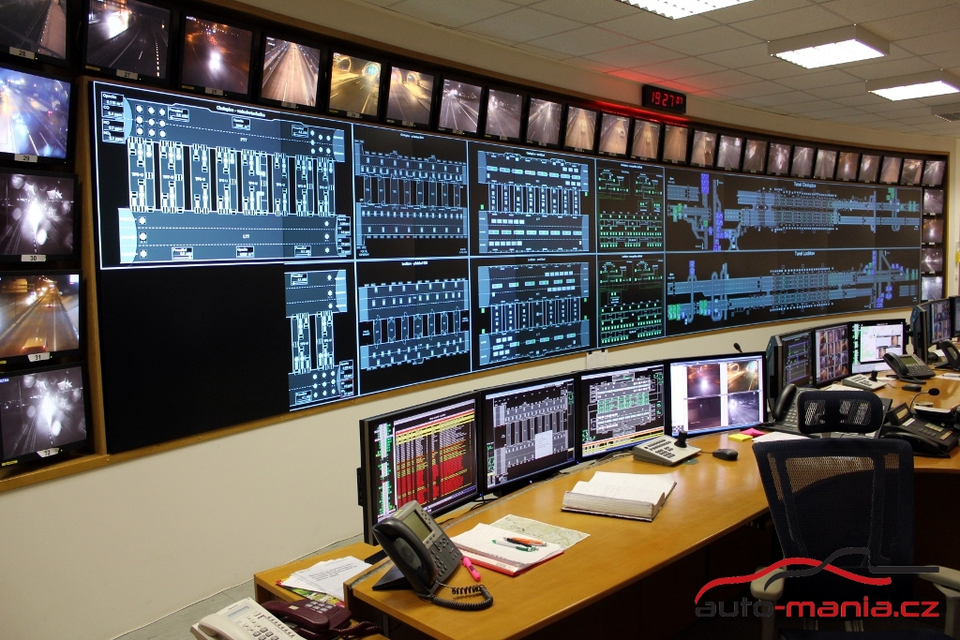
Control center in Rudná
4 operators 24/7
  2 of them for technological parts
  2 policemen for traffic control – traffic flow regulation (Prague Ring and the consequental sections of other highways)
HD overview display
32 small displays for the traffic control cameras points around the Prague Ring
Cooperation with National transport information center
Operation center for the Cerberus system

Slide 19
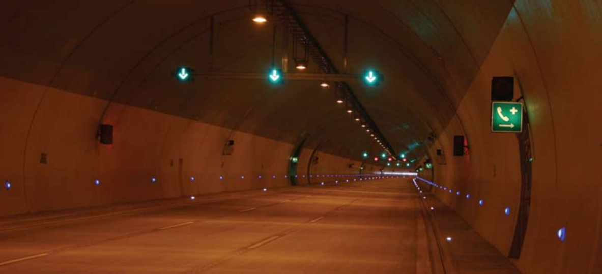
Tunnels – Cerberus system I/II
2 independent transformer stations at every portal
Rotary UPSs, diesel aggregates
Electricity sections divided according to fire brigade needs
Lighting for drivers visual comfort
  Changeable from entrance to inside
  Adapting to the light conditions outside
  Emergency lighting (1 m above the ground level)
Notes:
precaution
Uninterruptible power supply

Slide 20
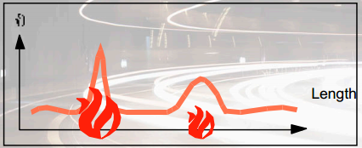
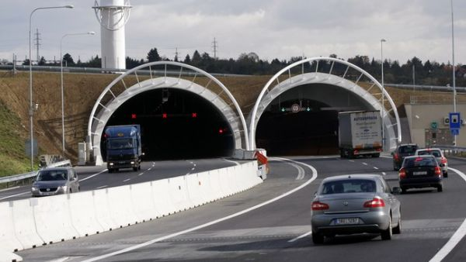
Tunnels – Cerberus system II/II
Air-handling systems
  Exhaust gases detection (NO_{x}, CO₂)
  Airflow detection (also in crossing passages)
  Fire detection
Siemens Cerberus® FibroLaser fire alarm detection cable
  Molecular structural changes in the laser light inside the cable
  Scattering of laser light varies in function of temperature
  Convected as well as radiated energy

Slide 21
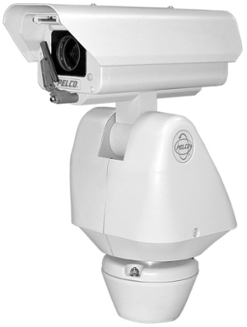
Camera systems
Cameras around the highways
Extra cameras by the tunnels covering all the places inside and subsequental zones
to the tunnels
35x zoom
Screen wipers
Analysis by video detection device (detection cards)
  Automatic detection of variety of events

Slide 22
Automatic detection I/III
Evaluation carried out through algorithms observing:
  Color changes in detected points
  Shade color-matching
Monitoring objects of various sizes in defined areas
Speed and direction of traffic flow
Smoke detection – gradual deterioration
of image quality

Slide 23
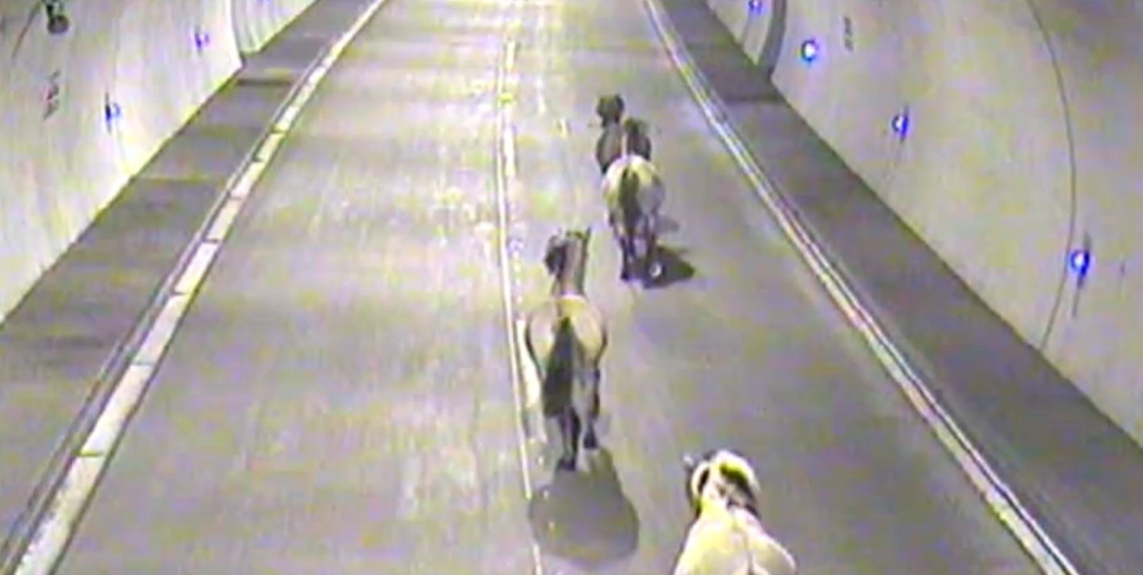
Automatic detection II/III
Stopped vehicle
Pedestrian or animal
in the tunnel
Driving in the opposite
direction
Fast or slow moving vehicles
Collecting traffic data with the parameters
of intensity, availability, speed
Vehicle classification
Notes:
http://tn.nova.cz/zpravy/regionalni/video-zvirata-na-silnici-kone-obsadili-tunel-svist-prekazel-formuli-1.html

Slide 24
Automatic detection III/III
Licence plates recognition – speed measuring
ADR plates recognition – infomation for fire brigade in case of problems
Self maintenance
  Individual cells separately evaluated
  by the algorithms for measuring of the quality
  and contrast of the image
Vehicles height measurement
  Prevention of damaging of the technology
  above the road (4,5 m)
  Automatic closure of the tunnel when needed

Slide 25
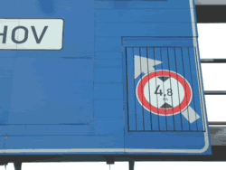
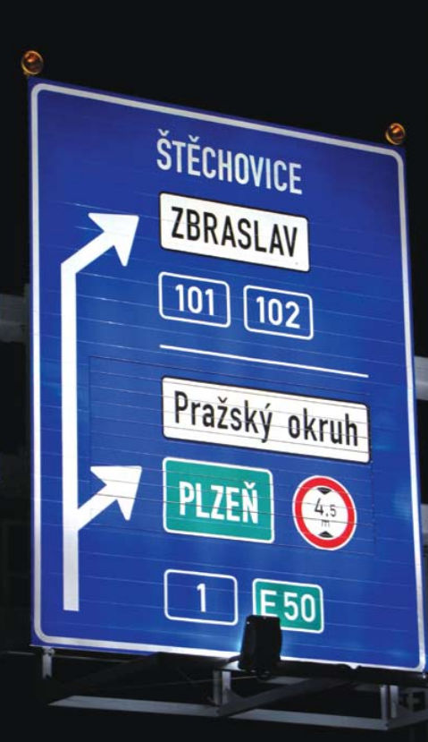



Traffic flow regulation
Mastering sections
are the tunnels
Changeable traffic signs
  mostly LED technology
    Brightness adjusting and fauls detecting
    100 lines signalization only in tunnels
  Lamellar traffic signs
    Crossing before tunnels for longer closures

Slide 26
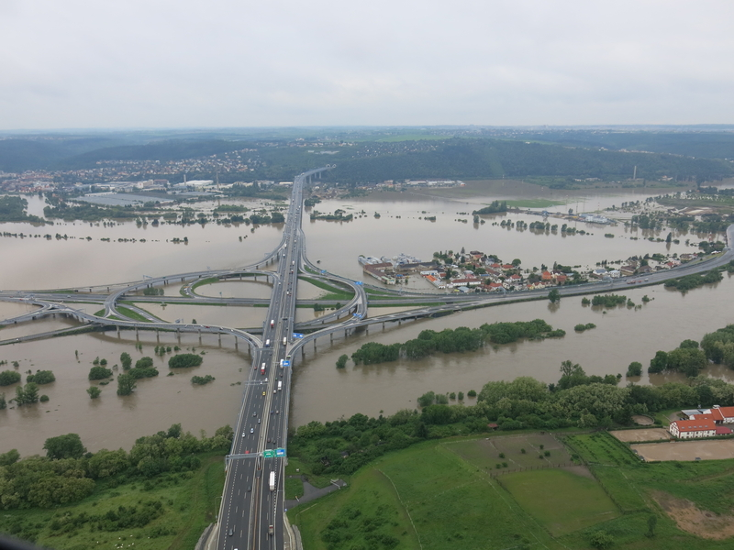
Meteorological information
Meteorological station based by the control center in Rudná
Thermomethers in each line
Icing reflective sensors
Salinity sensors
Cooperation
with the winter
maintenance service
Notes:
http://media.novinky.cz/614/376140-original1-hcdra.jpg

Slide 27
Sources
Road and Motorway Directorate of the Czech Republic
  http://www.rsd.cz/en
Technological equipment in Prague Ring
  http://www.asb-portal.cz/inzenyrske-stavby/tunely/technologicke-vybaveni-tunelu-na-prazskem-okruhu-2790.html
How does the operation center of the Prague Ring work?
  http://www.auto-mania.cz/exkluzivne-jak-funguje-dispecink-rizeni-dopravy-prazskeho-okruhu/
Siemens Cerberus® FibloLaser II
  http://www.cfaa.ca/files/flash/MEMBERSHIP/Siemens/Overview_of_Cerberus_FibroLaserII.pdf

Slide 28

Overview
The electronic toll system
Telematic control used at the Prague Ring
Traffic Management and Information System for Prague trams

Slide 29
DORIS Traffic Management and Information System for Prague trams
29/43

Slide 30
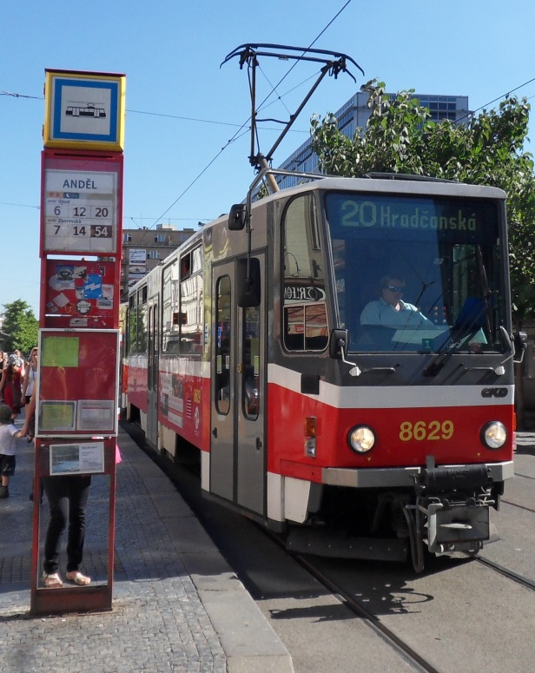
Prague Tram System
Essential part of Prague public transport system
Operational network
142.40 km
21 day lines, 9 night lines
Approximately 450 trains
in operation daily
311,057,000 passengers transported annualy
45,017,769 km annualy
Notes:
852 211 passengers per day
123 336 km per day

Slide 31
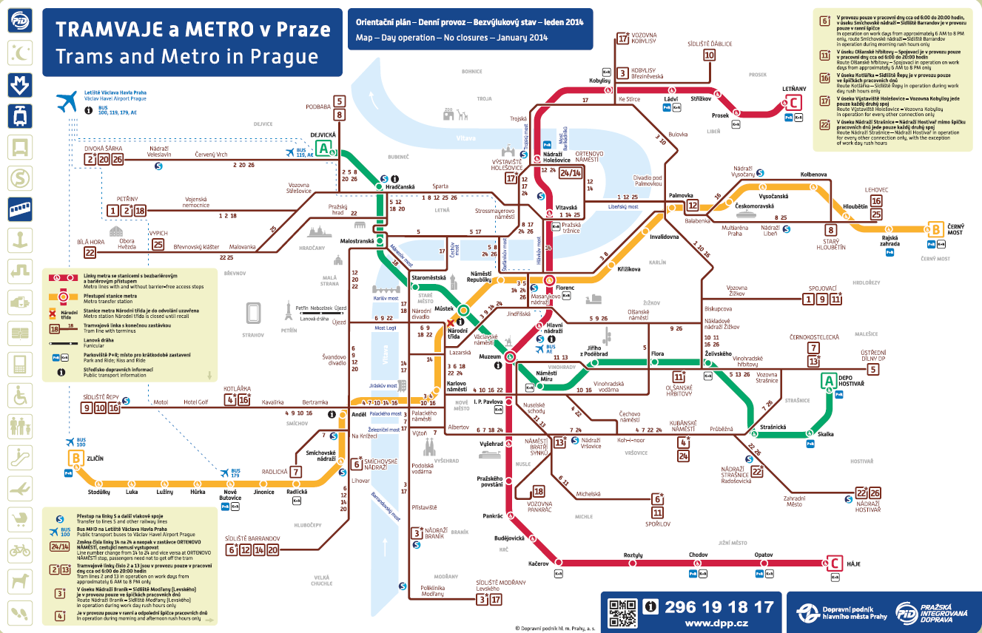

Slide 32
DORIS system
Information about the positions of trams
and their management
The system consists of 5 layers:
  Check points at chosen tram stops and places
  Radiostation, on-board computer and infrared beacon at every tram
  19 fixed radio basestations in the city
  (TETRA radio network)
  Operation control center
  Communicational layer: 2 simplex data radio channels and 3 simplex audio channels
Notes:
Terrestrial Trunked Radio

Slide 33
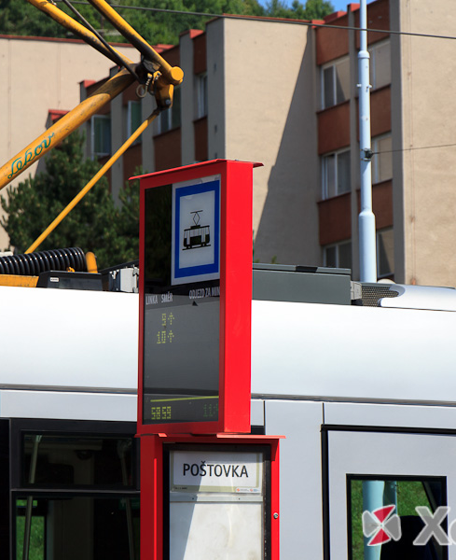
Check points
Infra red sensors in chosen tram stops – check points
  Terminals
  Stops by important crossings
  Stops by the metro stations
  Stops by the tram depots
Spacing 5 – 10 minutes
More check points
at the new tracks – also between stops
200 check points

Slide 34
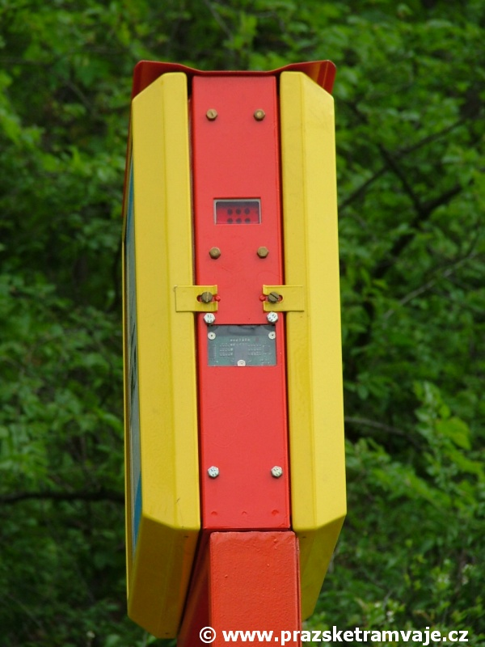
Tram trains localisation
Check points
Other stops recognized when the the voice information
for passengers is started
Every tram enters the system when its engine is started
The capacity of DORIS system is about 1,000 tramtrains
Notes:
http://www.xanthus.cz/referencni-projekty/

Slide 35
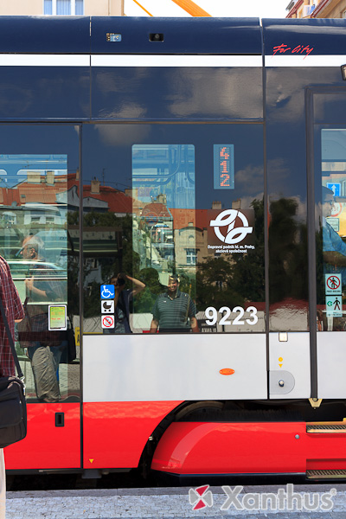
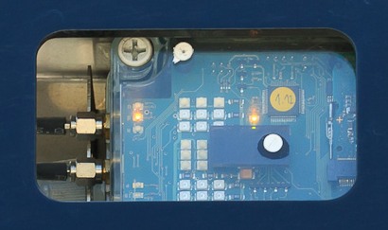
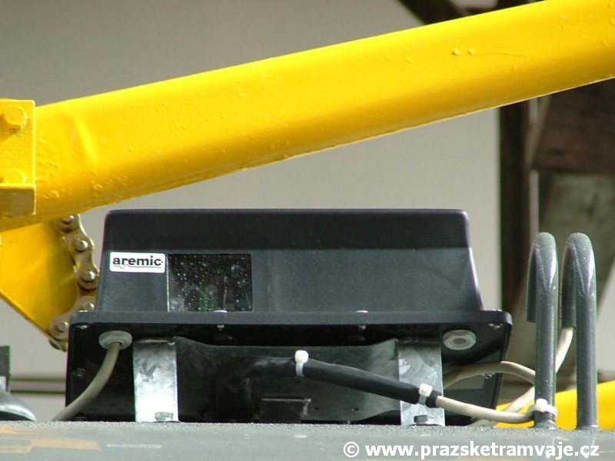
Trams
Infrared beacon
Radio station connected to the onboard computer sends the information from every stop
Notes:
http://www.xanthus.cz/referencni-projekty/

Slide 36
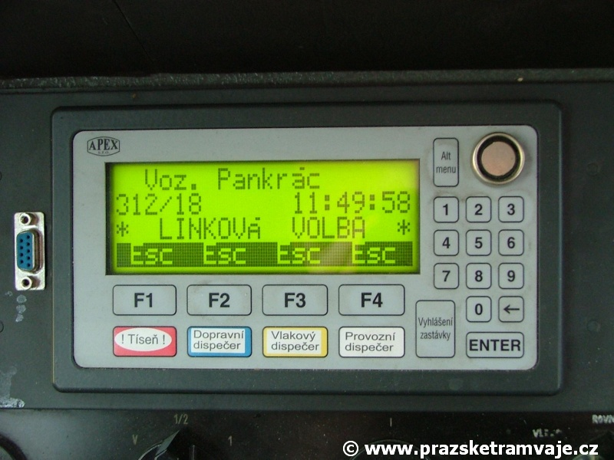
Connected stations
All tram computers
Operational control center
Tram depot
managers
PID system
dispatchers
Driver changing
locations

Slide 37
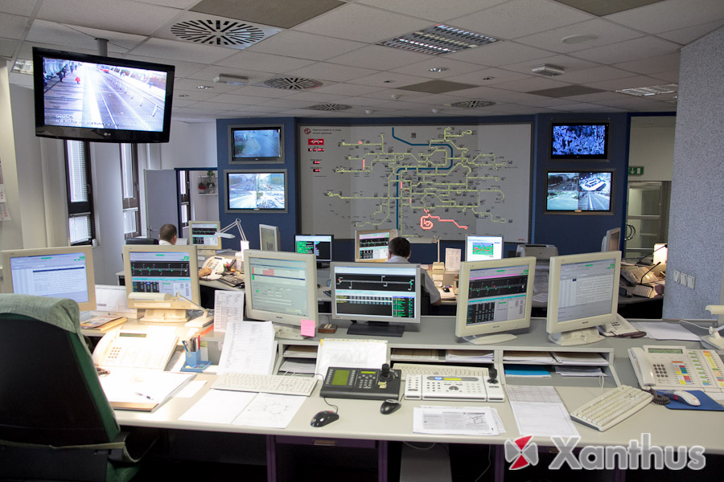
Operation control center
Displays with all trams in the network
Overview map with 4,000 diods
Controlling the positions according
to the timetable
Managing of all situations
Cooperation with other PID subsystems
Colors for dividing the types of trams
and the delays

Slide 38
Displayed colors
Green – delay 0 – 179 s
Red – ahead the timetable 1 s or more
Red blinking – ahead the timetable 1 minute or more
Yellow – delay 180 – 419 s
Yellow blinking – delay more than 419 s
White – delay reaches the length of the pause
at the terminal stop
White blinking - delay exceeds the length of the pause at the terminal stop
Purple, gray, blue – special cases (route changes, depots, service trains, computer problem)
Notes:
Zeleně zobrazený vlak jede v toleranci, tedy je zpožděn o 0 až 179 sekund.
Červeně zobrazený vlak jede napřed o více jak 1 sekundu.
Červeně blikající zobrazený vlak jede napřed o více jak 1 minutu.
Žlutě zobrazený vlak je zpožděn o více jak 180 až 419 sekund.
Žlutě blikající zobrazený vlak je zpožděn o více jak 420 sekund.
Bíle zobrazený vlak je zpožděn o dobu svého obratového času na nejbližší konečné.
Bíle blikající zobrazený vlak je zpožděn o více než činí obratový čas na nejbližší konečné.
Šedě zobrazený vlak zatáhl do vozovny nebo se teprve připravuje k výjezdu (palubní počítač je aktivní).
Šedě inverzně zobrazený vlak není v síti (zatažen ve vozovně dle JŘ), ale má určený JŘ pro tento den.
Fialově zobrazený vlak dočasně nekomunikuje s řídicím počítačem.
Fialově inverzně zobrazený vlak má být dle JŘ na trase, ale má závadu palubního počítače, případně je překódován na jiné pořadí (tedy jde například o vlak odstavený po mimořádné události,případně jede na opravu nebo výměnu vozu či řidič špatně nakódoval linku nebo pořadí, nebo vůbec nevyjel z vozovny).Světle modře zobrazený vlak sjel z trasy určené jízdním řádem.
Azurově zobrazený vlak je neurčený jízdním řádem, jde tedy o záložní vlaky, manipulační, zkušební, cvičné jízdy, vlaky po nehodě apod., ale je osazen fungující radiostanicí.

Slide 39
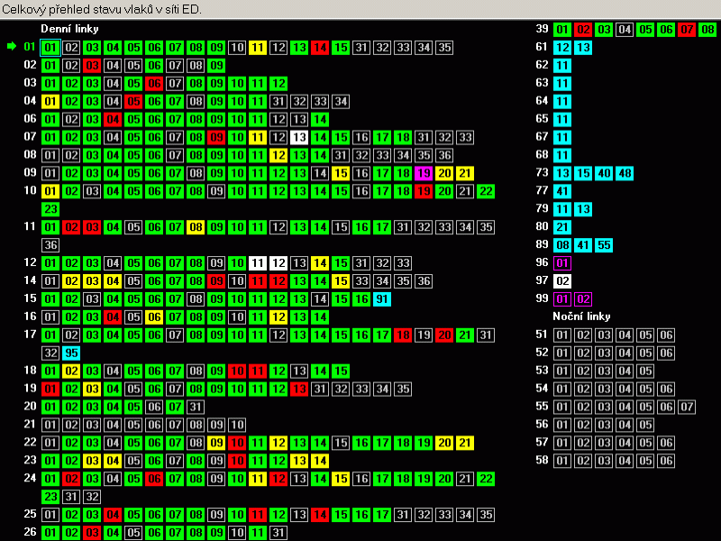
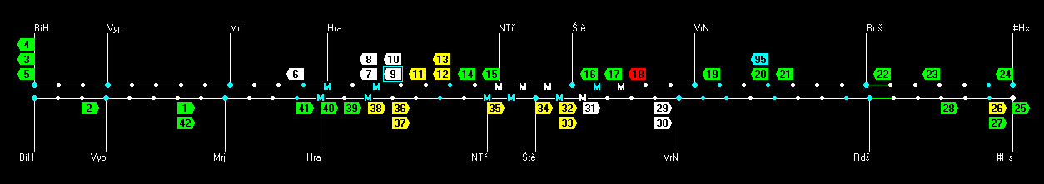

Slide 40
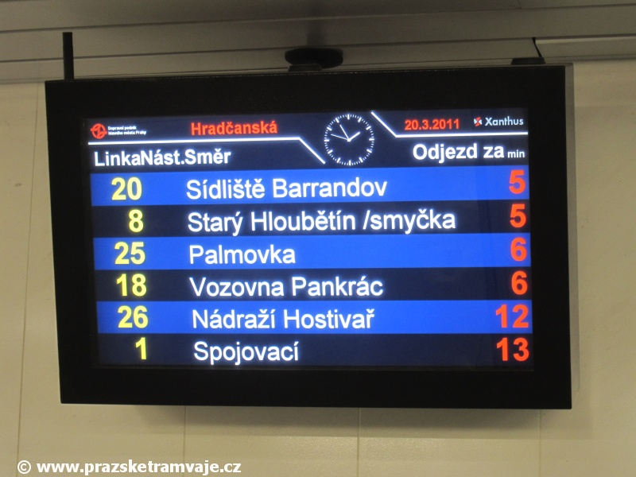
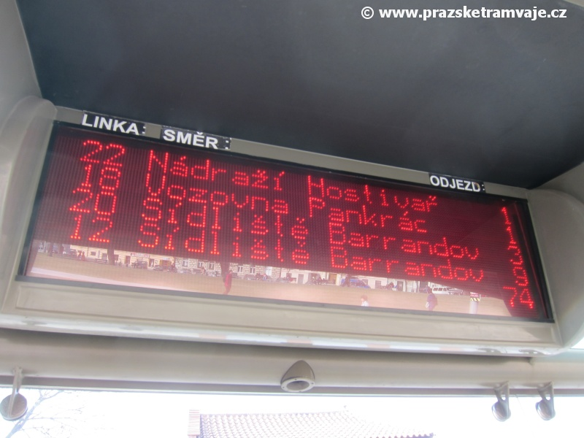
Automatic control features
Sound alarm when the tram is going ahead
the timetable at the check points
Sound information for the driver at the terminals
Automatic synchronization of the voice information about stop and next stop
at the check points
Time synchronization for ticket validators
Dispatchers directive for multiple departure
Online information for tram stops information system (Reliability)

Slide 41
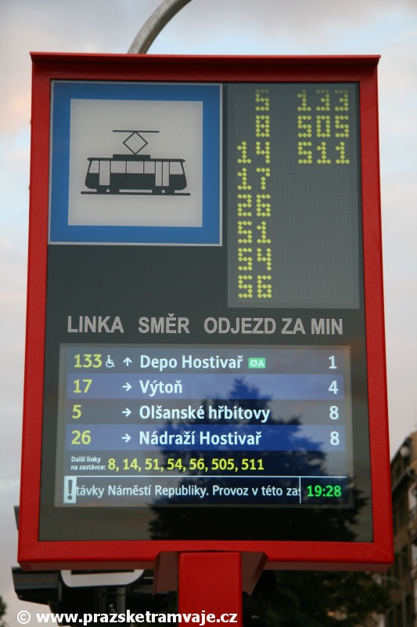
Cooperation with other systems
DORIS started in 1990s
New system for dispatching of buses based on GPS – AUDIS system
Emergency systems
Information for passengers

Slide 42
Sources
Prague Trams:
  http://www.prazsketramvaje.cz/
Regional Organizator of Prague Integrated Transport System:
  http://ropid.cz/?Lang=en
Prague Public Transport Company:
  http://www.dpp.cz/en/

Slide 43
Time for your questions…
…Thank you for your attention!

